Slide 1

Team Name : Project Argus
Team Leader Name : Keerat Khanuja
Problem Statement : (Track: AI for Communities, Access & Public Impact) Preventing rental listing scams in Indian cities using AI-powered verification.

Slide 2

Brief about the Idea:
Project Argus is an AI-powered rental listing verification system designed to protect renters in Indian cities from online housing scams.
Every year, millions of students, job seekers, and migrant families move to urban centers in search of housing. In this urgency, many fall victim to fraudulent listings that use stolen property images, fake addresses, unrealistically low prices, and brokers who disappear after taking advance payments. Today, renters have no automated way to verify whether a listing is genuine before sending money.
Project Argus acts as a trust layer between rental listings and renters. Users simply paste a listing link or enter listing details, and within seconds our AI analyzes multiple fraud signals such as pricing anomalies, image reuse across listings, suspicious language patterns, and broker posting behavior.
The system then generates a clear risk score with explanations, allowing users to make informed decisions before contacting brokers or making payments. Unlike rental platforms that only host listings, Argus focuses on verification and fraud detection, helping prevent financial loss and protecting vulnerable users. Our long-term vision is to make rental verification as common as spam detection in email — an invisible but powerful protection layer that keeps users safe.
Project Argus aims to bring trust, safety, and transparency into India’s rapidly growing digital rental ecosystem.

Slide 3
Our Solution :
Project Argus differs from existing rental platforms by acting as an independent AI-powered verification layer rather than just hosting listings. Instead of relying on a single signal like reviews or pricing, it analyzes multiple factors simultaneously—price anomalies, reused images, scam language, and broker behavior—to detect fraud patterns that scammers cannot easily fake. By providing instant risk scores with clear explanations before users make payments, Argus helps renters avoid scams proactively. Its USP lies in real-time, multi-signal fraud detection designed specifically for Indian rental markets, making property search safer, faster, and more trustworthy across platforms.

Slide 4
List of features offered by the solution –
• Price Anomaly Detection – Flags listings priced far below real market rates • Image Similarity Detection – Detects stolen or reused property photos • Scam Language Detection – Identifies urgency and payment pressure tactics • Broker Pattern Detection – Flags repetitive or suspicious broker activity • AI Risk Scoring – Generates clear scam risk score (Genuine / Suspicious / High Risk) • Explanation & Safety Tips – Users see why a listing is risky • Instant Analysis (<10 sec) – Fast, real-time verification • Mobile-Friendly Interface – Simple verification for everyday users

Slide 5
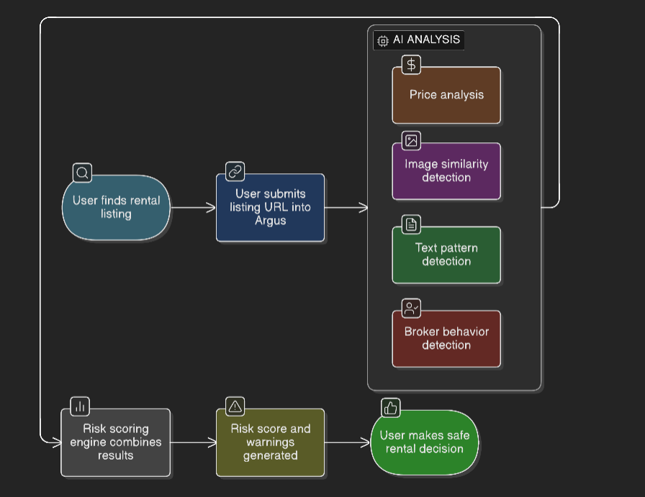
Use-case flow shown in process diagram -
.

Slide 6
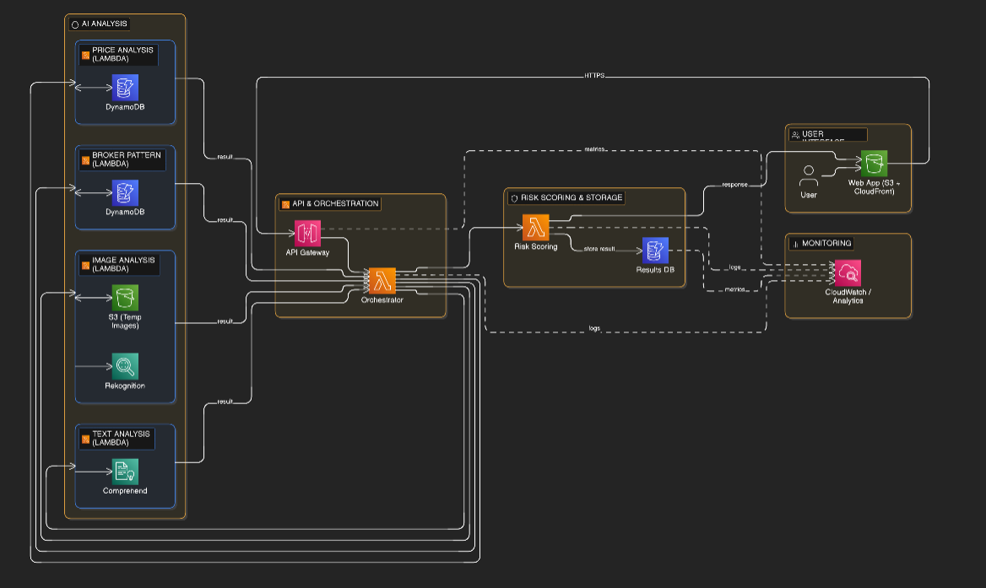
Architecture diagram –

Slide 7
Technologies to be used in the solution:
Frontend • React.js (Web Interface) • TailwindCSS (UI Design)
Backend & Cloud • AWS Lambda (Serverless Compute) • Amazon API Gateway (API Management)
AI & ML Services • Amazon Rekognition (Image Analysis) • Amazon Comprehend (Text & NLP Analysis)
Database & Storage • Amazon DynamoDB (Listing & Analysis Data) • Amazon S3 (Image Storage)
Deployment & Delivery • Amazon CloudFront (Content Delivery) • AWS IAM & CloudWatch (Security & Monitoring)

Slide 8
Estimated implementation cost :
• MVP infrastructure cost: $30–50 per month using AWS serverless services • Costs scale with usage due to pay-per-use architecture • Minimal upfront infrastructure investment required • Suitable for rapid scaling without major hardware costs

Slide 9
Real-World Impact –
• Helps prevent rental fraud and financial loss for students, migrants, and families relocating to cities • Builds trust in India’s digital rental ecosystem through AI-powered verification • Protects vulnerable renters before scams occur, not after • Scalable solution that can expand across cities and integrate with rental platforms nationwide • Potential to save crores of rupees annually by reducing rental scams

Slide 10


